Slide 1
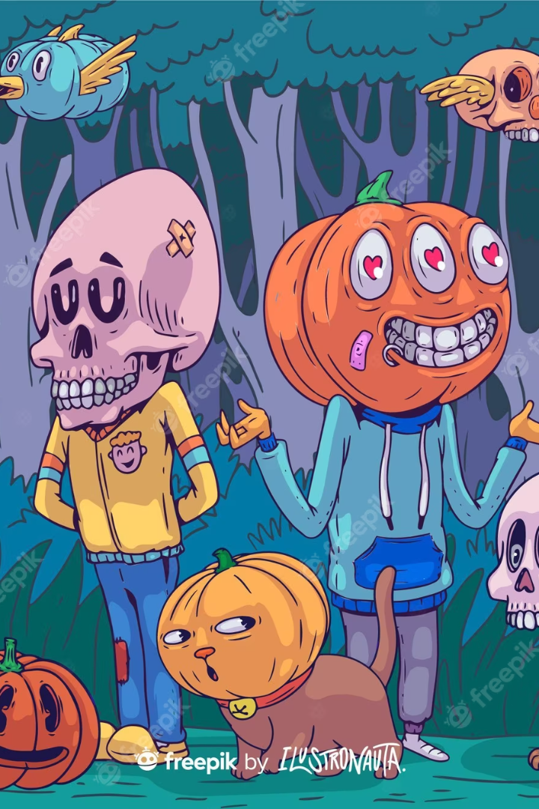
kennesaw state university
Machine vision
Cartoonifying an Image using Machine Vision
Name: Dhanusha Sonari
ID:001094045

Slide 2
Project Objective
Objective
Importance
Applications
We aimed to create a machine vision program that can convert regular images into cartoon-style images.
This project has significant implications in the field of entertainment and image processing by generating compelling content for social media, blogs, and advertisements.
The technique can be applied in animation, game development, avatar creation, and social media messaging.

Slide 3
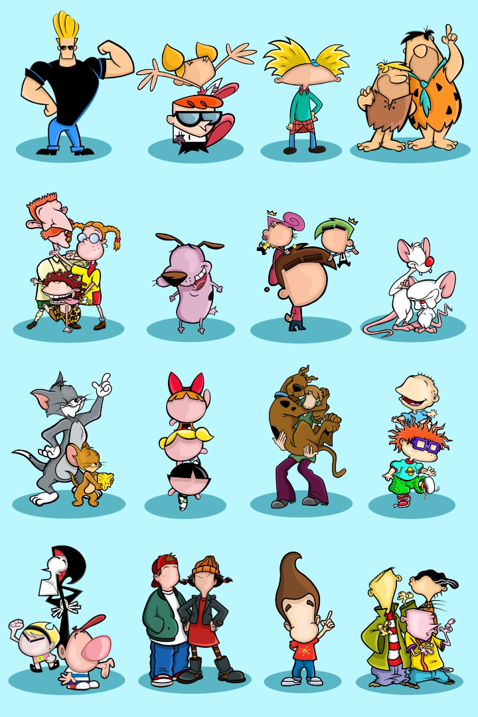
Problem Statement
1
The Issue
The problem is how to convert regular images into cartoon-style images while preserving essential features.
2
Challenges
The main challenges are maintaining key features, natural color processing, and providing user customization options.

Slide 4
Methodology Overview
Grayscale Conversion
Smoothening
Edge Detection
Masking
Reduce noise and preserve essential features by using Gaussian smoothen and smoothing properties.
Identify the key features and edges using Canny edge detection and related algorithms.
Create the cartoon-like effect by applying masking techniques to preserve the cartoonish outline while reducing clutter.
Convert the image to grayscale by removing the color information.

Slide 5
Grayscale Conversion
1
Step 1. Grayscale Conversion
Convert the image to grayscale by removing the color information.

Slide 6
Smoothening
1
Step 2. Smoothening
Reduce noise and preserve essential features by using Gaussian smoothen and smoothing properties.

Slide 7
Edge Detection
1
Step 3. Edge Detection
Identify edges and key features using Canny edge detection and related algorithms.

Slide 8

Masking
1
Step 4. Masking
Create the cartoon-like effect by applying masking techniques to reduce clutter and preserve the cartoonish outline.

Slide 9
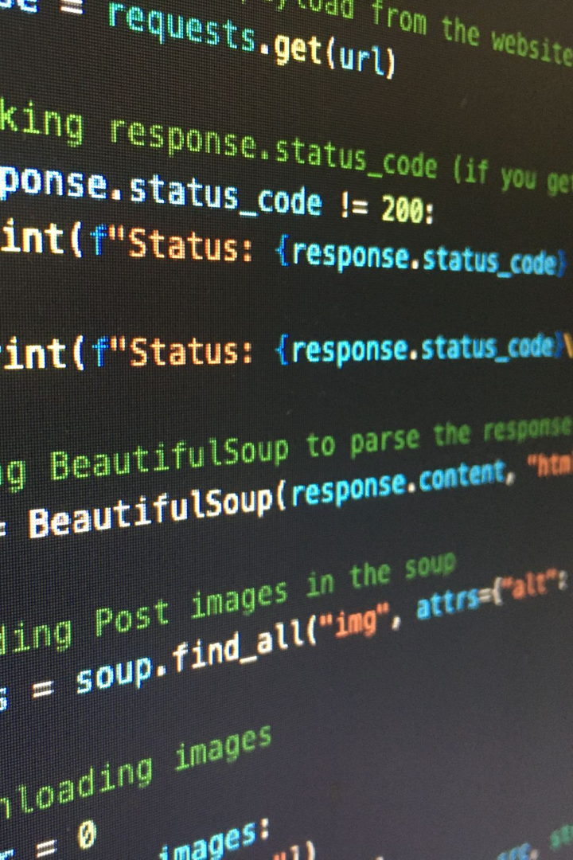
Implementation Details
1
Python Code
The Python code used for the cartoonization process can be found on our GitHub repository.
2
OpenCV Library Functions
OpenCV library functions were used in each step of the methodology, including grayscale conversion, smoothening, edge detection, and masking.

Slide 10

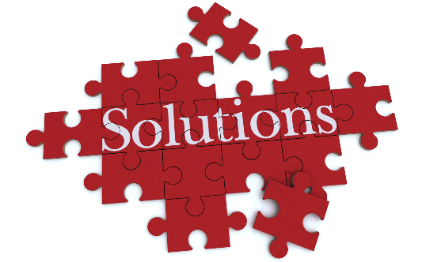

Challenges and Solutions
Challenges
Solutions
Results
The main challenges were maintaining key features, natural color processing, and providing user customization options.
we have addressed these issues by employing a combination of specialized techniques, such as smoothening and masking, and incorporating user control options.
The final results demonstrate high-quality cartoonization and satisfactory color processing.

Slide 11
Results and Comparisons
Result 1
Result 2
The cartoonized images illustrate high-quality and satisfying color processing.
The cartoon filter produces image stylization comparable to other popular cartoonization methods in the industry.

Slide 12

Performance Analysis
1
Speed and Efficiency
2
Optimizations
Our cartoonization algorithm operates at a high speed with decent efficiency.
We recommend creating an API to improve user experience and faster processing time. Additionally, integrating AI technology, such as deep learning neural networks, could further improve the cartoonization algorithm.

Slide 13
Applications and Use Cases
Animation and Game Development
Social Media
and Messaging
Artistic Purposes
Users can create customized personal cartoonized avatars for social media and messaging purposes using the cartoonization program.
The cartoonization program has significant implications in artistic purposes, such as creating unique and innovative visual art and graphic designs.
The cartoonization program can be applied in animation and game development by generating compelling and unique characters.

Slide 14
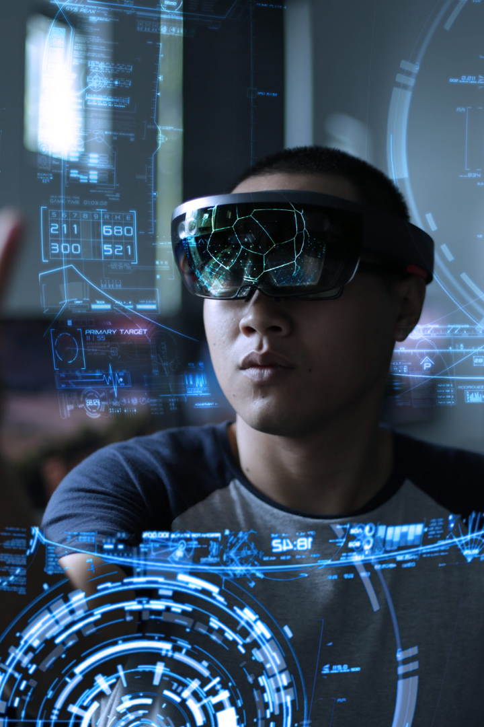
Future Enhancements
1
Improving User Experience
2
Integration with AI Technology
Creating a user-friendly API to simplify the image processing process and provide more customization options.
Incorporating state-of-the-art deep learning neural networks could significantly improve the quality of the cartoonization algorithm.
3
Real-Time Image Processing
The team plans to investigate the feasibility of real-time image processing in potential applications, such as video games and animation.

Slide 15
Video presentation link :
https://kennesawedu-my.sharepoint.com/:v:/r/personal/dsonari_students_kennesaw_edu/Documents/Recordings/Meeting%20with%20Dhanusha%20Sonari-20230724_222617-Meeting%20Recording.mp4?csf=1&web=1&e=1bF6RU

Slide 16
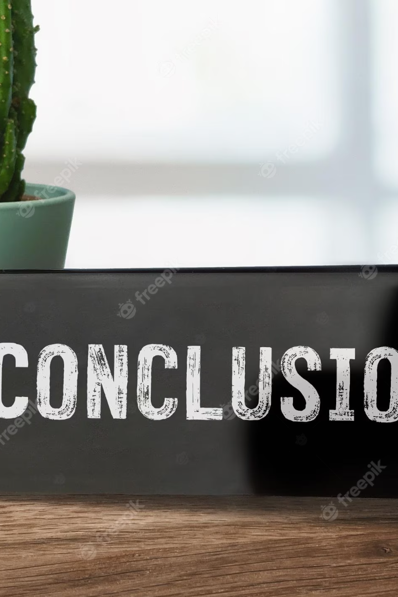
Conclusion
Our project has developed a cartoonization program using machine vision techniques, contributing to the development of image processing and entertainment. The program provides high-quality cartoonization with customizability and speedy operation, making it an ideal tool for animation, social media, and artistic applications.

Slide 17

Acknowledgments
I would like to acknowledge our supervisor and collaborators for their guidance and support throughout the project. Thank you for giving us this opportunity to contribute to the machine vision community.

Slide 18

Questions and Answers
If you have any questions or inquiries regarding the project

Slide 19

Thank You
Thank you for taking the time to learn about our project. We are excited about the advancements in machine vision and image processing and look forward to contributing to this exciting field.

